Slide 1


JAYOTI VIDYAPEETH WOMEN’S UNIVERSITY ETCDWP – II 2019 INTERNATIONAL CONFRENCE MOBILE IP
NIKITA PRAJAPAT
JV-U/18/2143
ANSHIKA PARIHAR
JV-U/18/2131
BCA 2ND SEMESTER

Slide 2
CONTENT
Introduction
Need of Mobile IP
Application of Mobile IP
Advantage of Mobile IP
Disadvantage of Mobile IP
Conclusion
Reference

Slide 3
Introduction
Mobile IP communication protocol refers to the forwarding of Internet traffic with a fixed IP address even outside the home network. It allows users having wireless or mobile devices to use the Internet remotely.
Mobile IP is mostly used in WAN networks, where users need to carry their mobile devices across different LANs with different IP addresses.
Mobile IP is not a wireless protocol. However, it could be employed for the IP infrastructure of cellular networks.

Slide 4
Need of mobile IP
A better analogy for internet attachment is the growth of mobile cellular phone on their past decade.
A vigor is attain by using technology that permit a user to maintain a constant link to the recipient and vice versa. A big difference in the analog is a reality that it took as a long time for mobile phone to suit accepted in the buyer market.
A prohibitive cost of cellular technology and limited area of coverage discourage many user for using cellular mobile.
Moving computing is guaranteed to become hot technology as taking of moving gadget that also can be modified to support internet entry is already popular with buyer

Slide 5
Application of Mobile IP
1. The Mobile Node (MN): Travels to a foreign network and gets a new care-of-address.
2. The MN performs a binding update to its Home Agent (HA) the new care-of-address gets registered at HA
3. A Correspondent Node (CN) wants to contact the MN. The HA intercepts packets destined to the MN.
4. The HA then tunnels all packets to the MN from the CN using MN's care-of-address.
5. When the MN answers the CN, it may use its current care-of-address and communicate with the CN directly or it can tunnel all its packets through the HA.

Slide 6
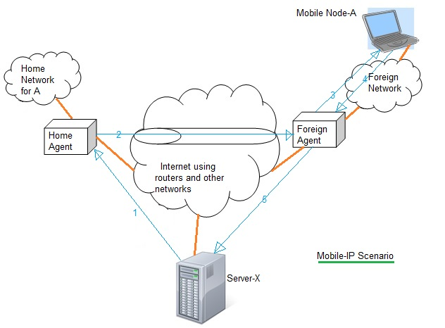
Block diagram

Slide 7
Advantage of mobile IP
It allows fast, continuous low‐ cost access to corporate networks in remote areas where there is no public telephone system or cellular coverage.
It supports a wide range of applications from Internet access and e‐mail to e‐commerce.
Users can be permanently connected to their Internet provider and charged only for the data packets that are sent and received.
A user can take a palmtop or laptop computer anywhere without losing the connection to the home network.

Slide 8
Disadvantage of Mobile IP
There is a routing inefficiency problem caused by the “triangle routing” formed by the home agent, correspondent host, and the foreign agent.
Security risks are the most important problem facing Mobile IP.
Issue related to the security is how to make Mobile IP coexist with the security features coming in use within the Internet.

Slide 9
Conclusion
As this introductory paper has shown, Mobile IP has great potential. Within the IETF(internet engineering task force), Mobile IP already has a large number of both RFCs and Drafts, which indicates that Mobile IP has been a well researched field and that a great deal of current research is ongoing as well.
Test outcome have given added believe that the Mobile IP identification is sound, implement able, and of diverse interest throughout the Internet community.
Mobile Internet protocol specification has also been easily interpreted by web agreement engineers and web programmers.

Slide 10
Reference
1.yi-an chen , a survey paper of mobile IP, pg. 1 to 12.
2. Kunal Ganguly “A study of mobile IP”, journal name: - CS843 Distributed Computing Systems ,Year:-2004, Pg. no.o1 to 12.
3.Janani Chandrasekaran “: Issues , mobile IP Challenge and solution” Department of Electrical and Computer Engineering Rutgers University “ year 2006

Slide 11
Thank You

